Slide 1
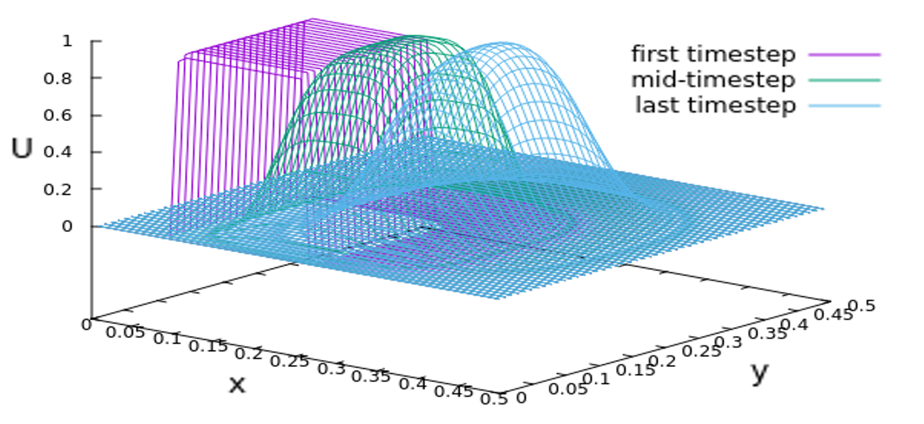
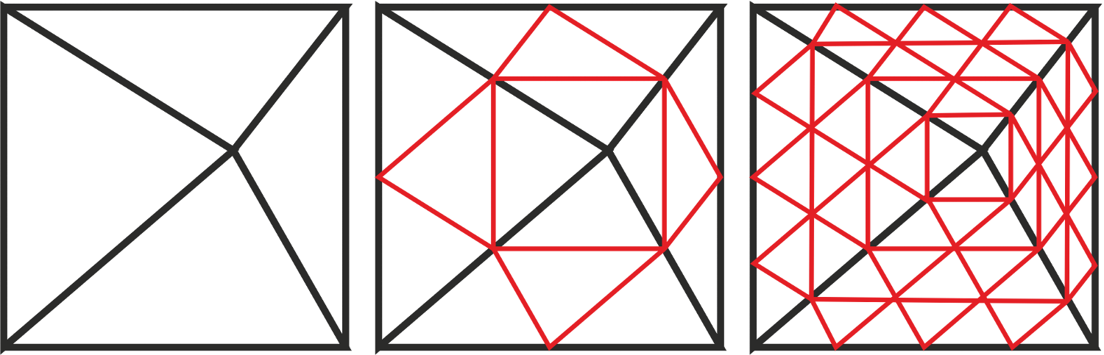
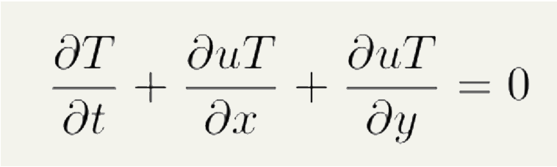
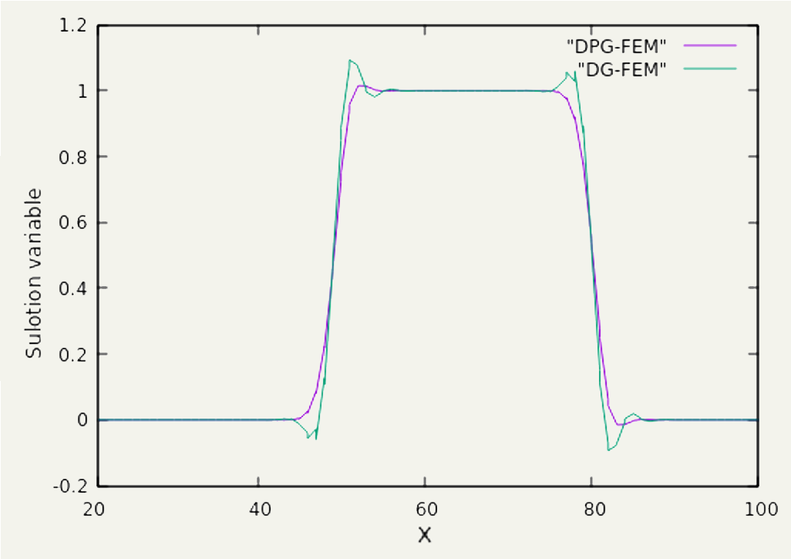
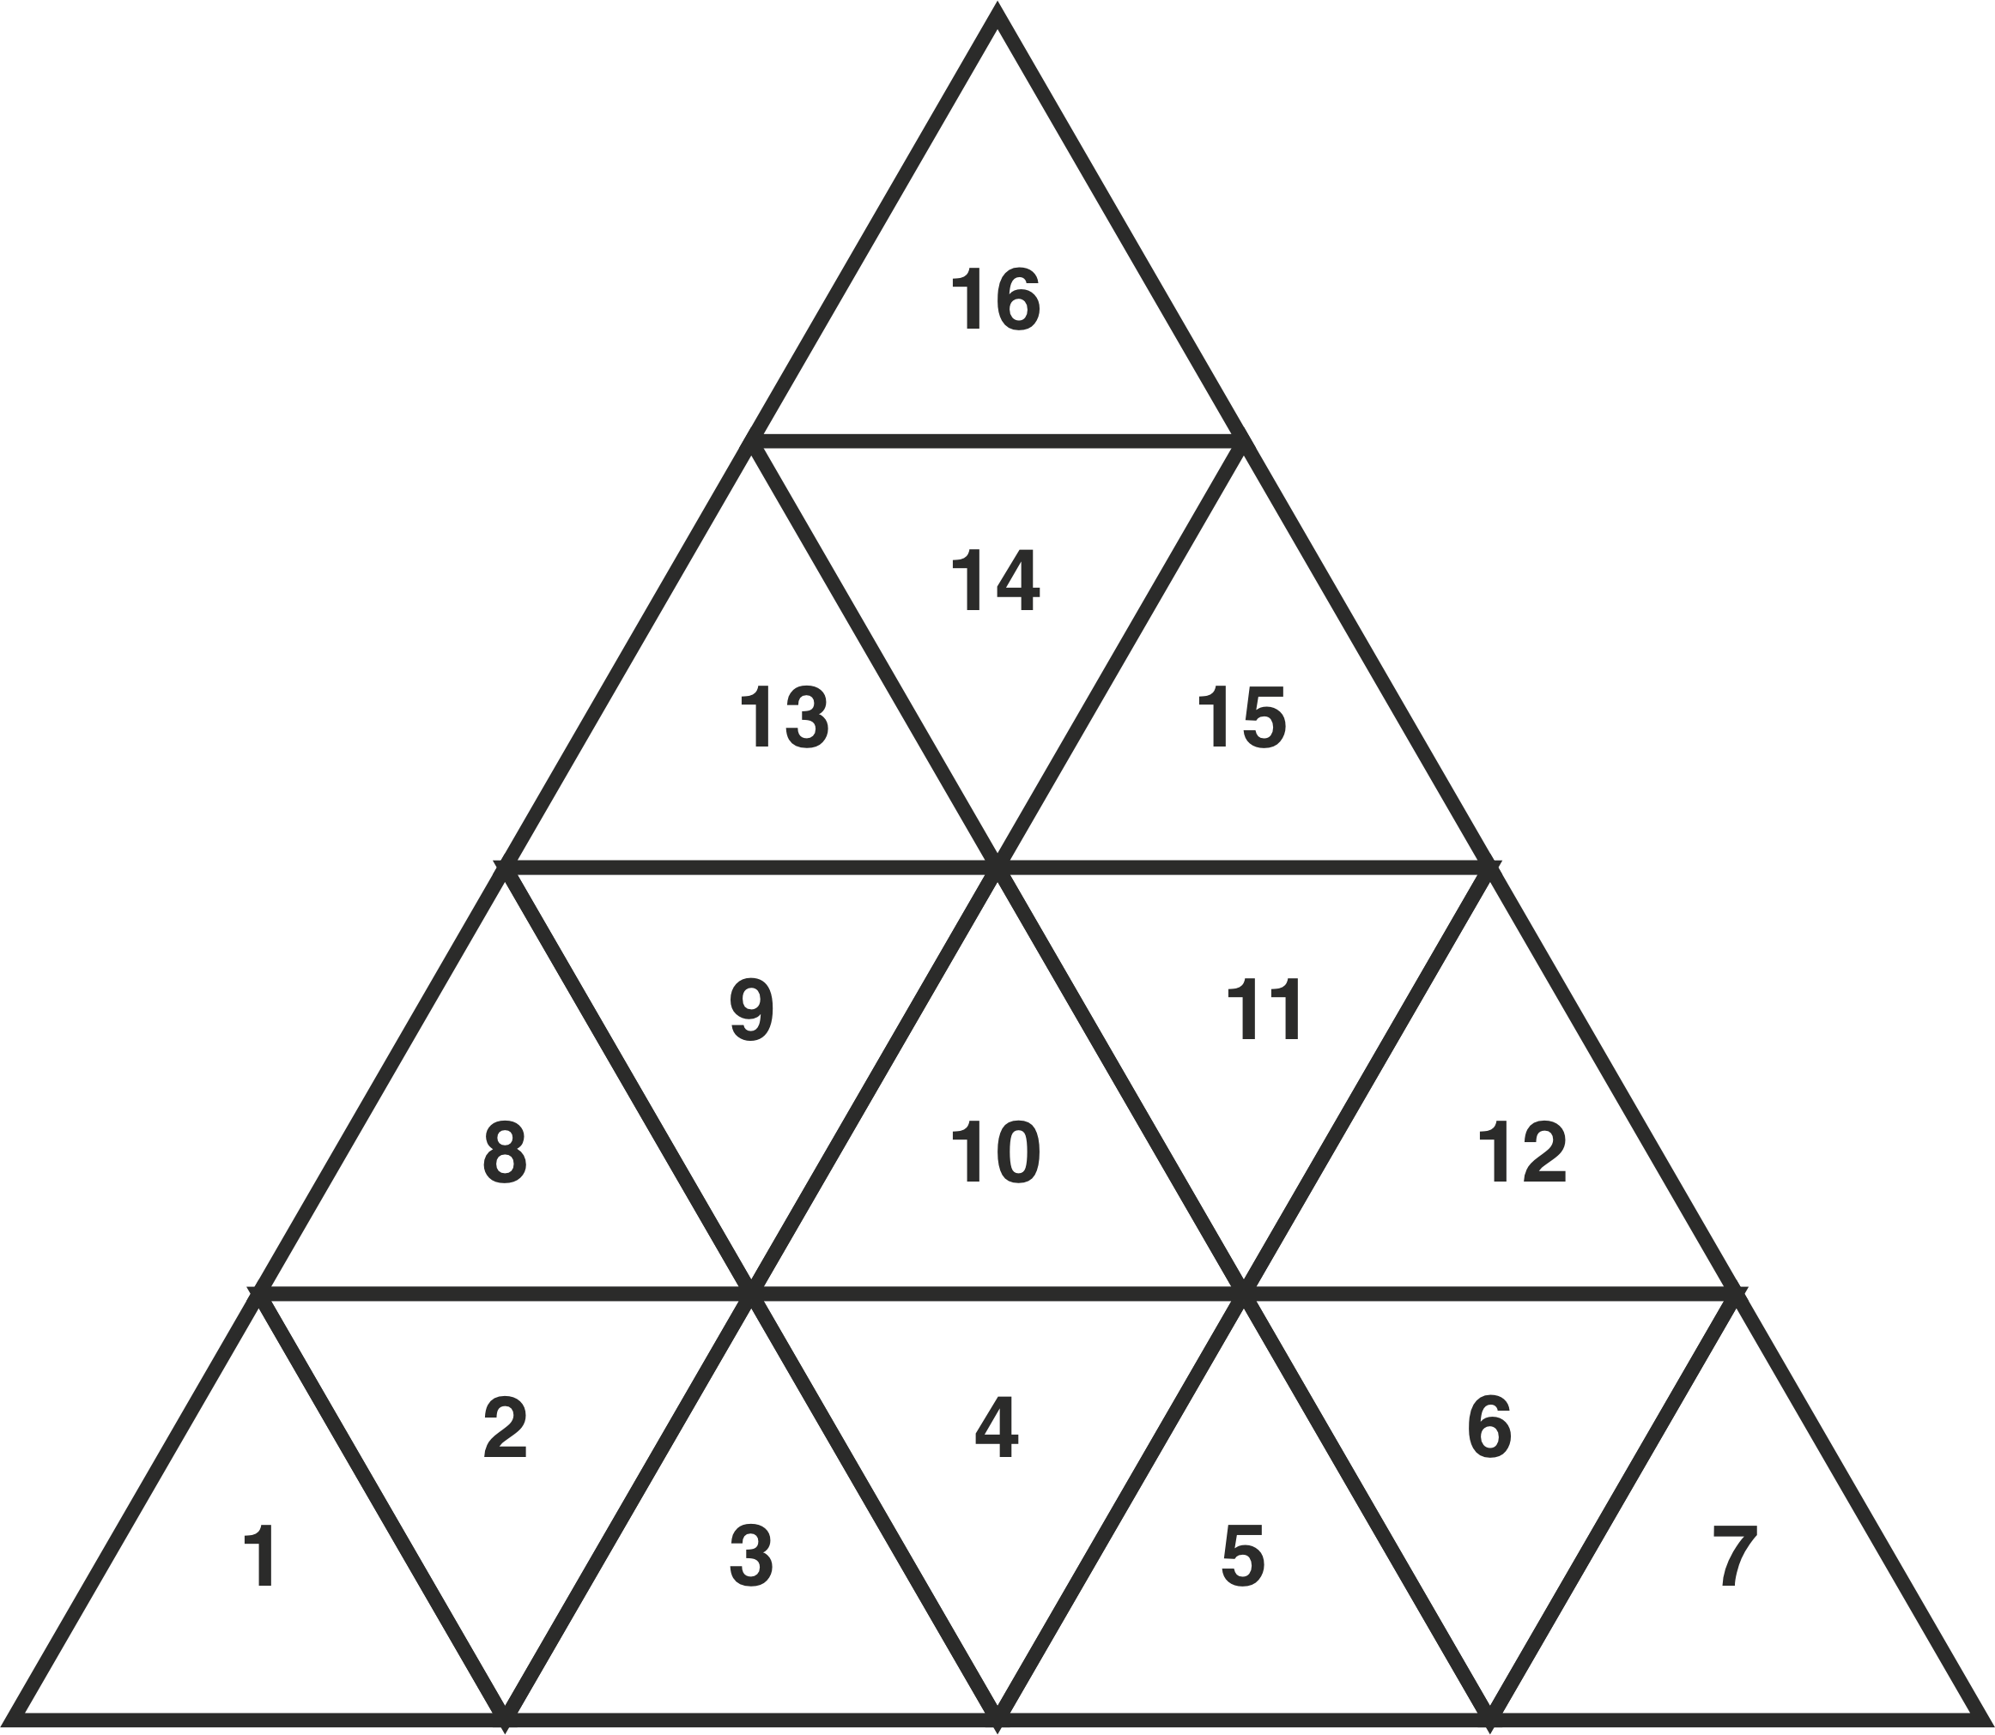
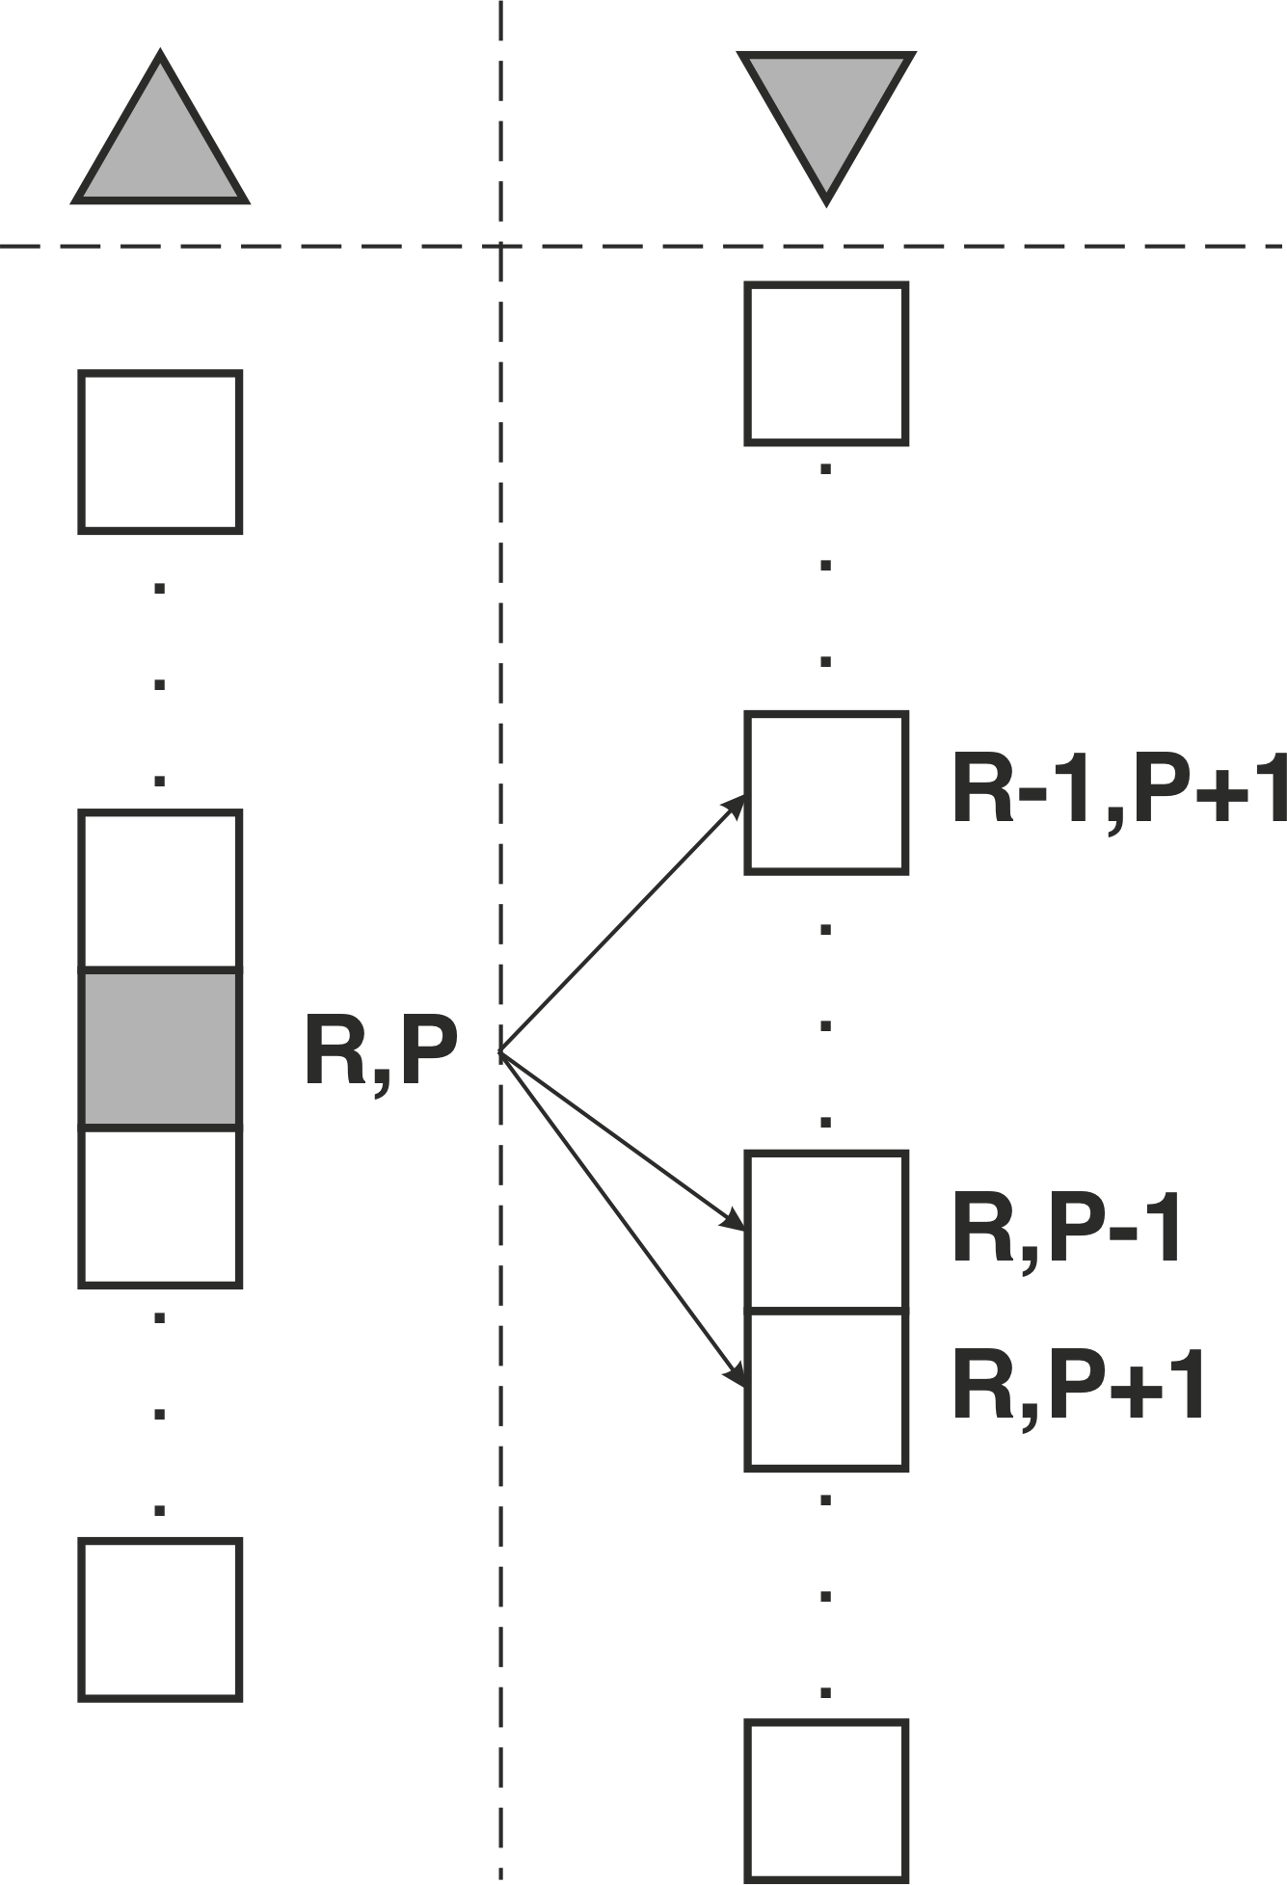
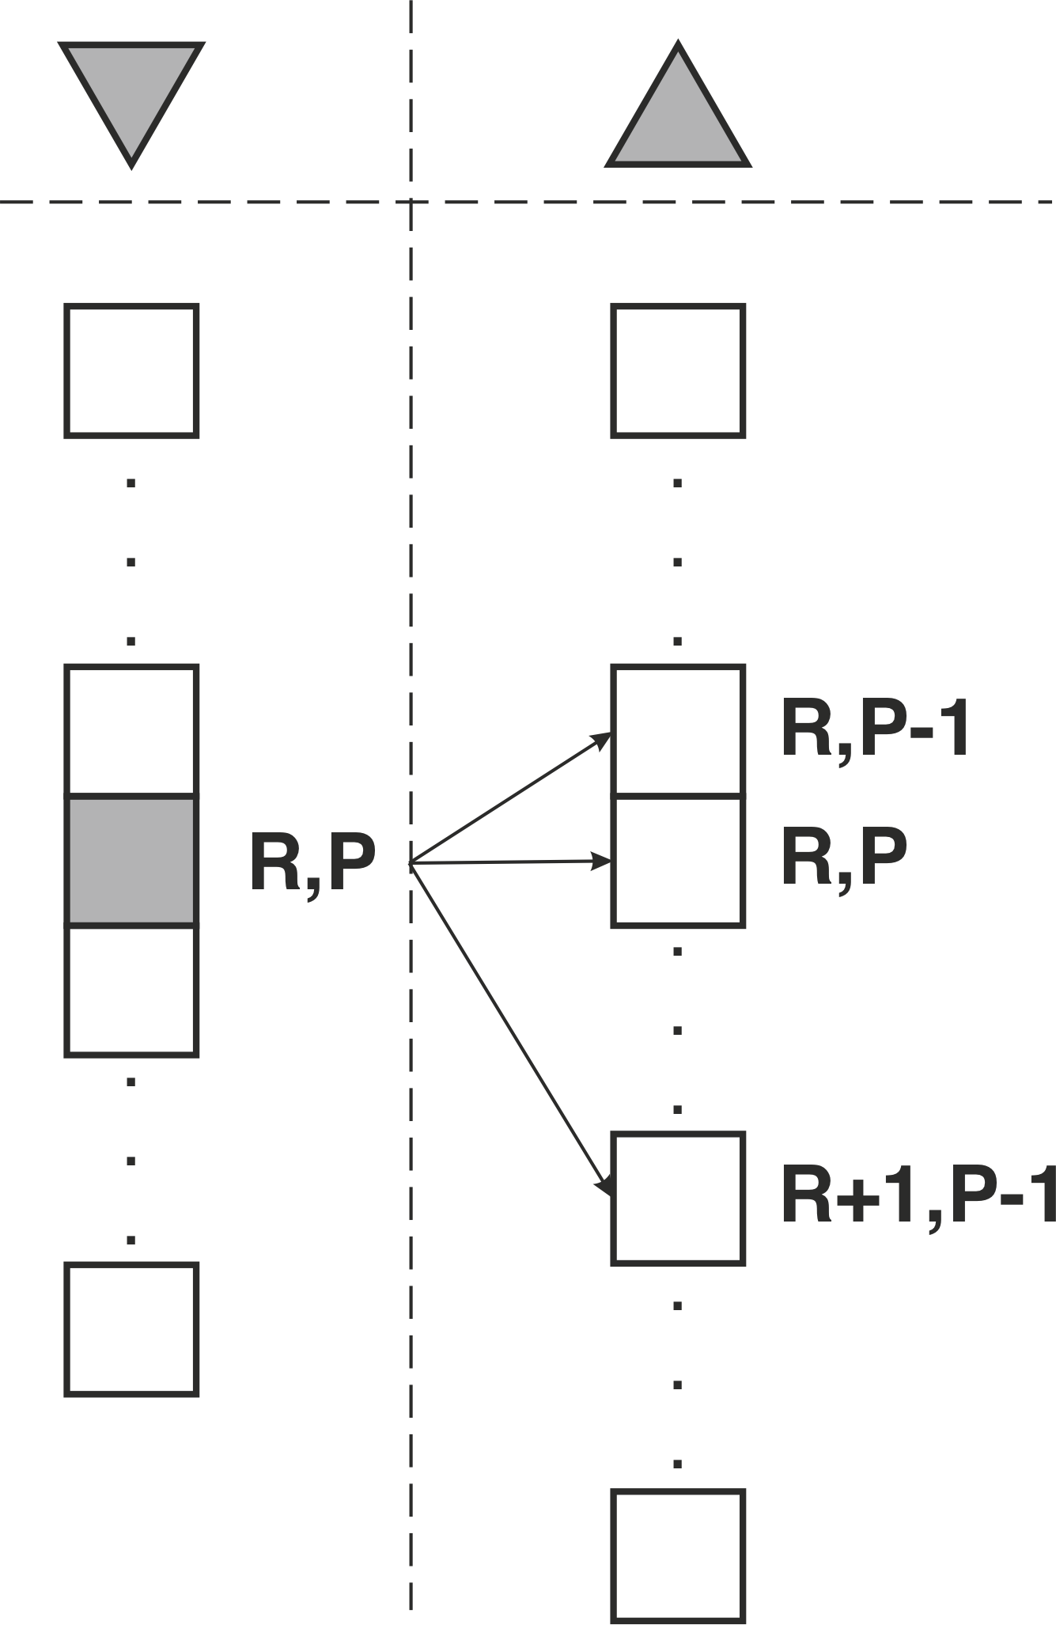
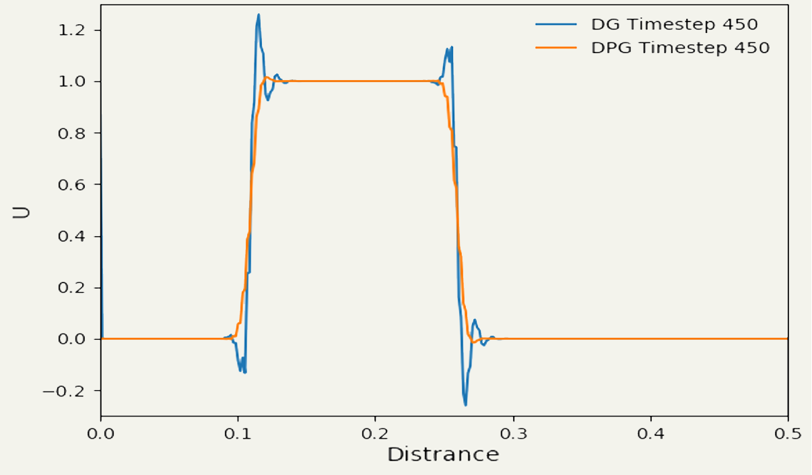
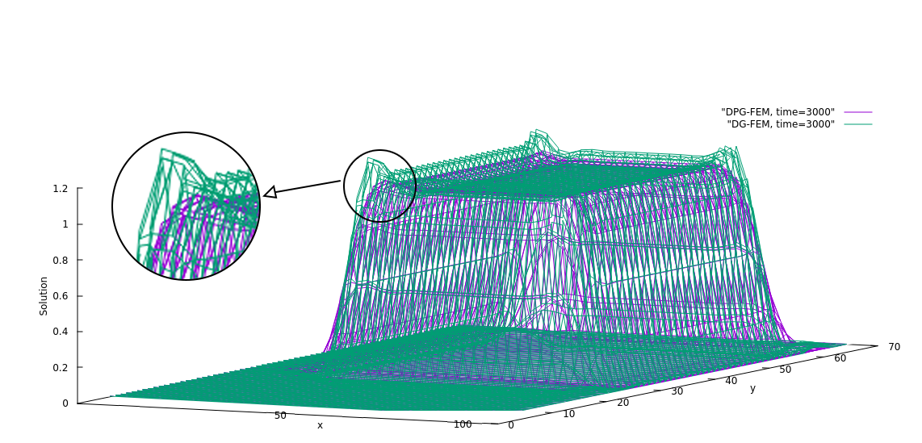
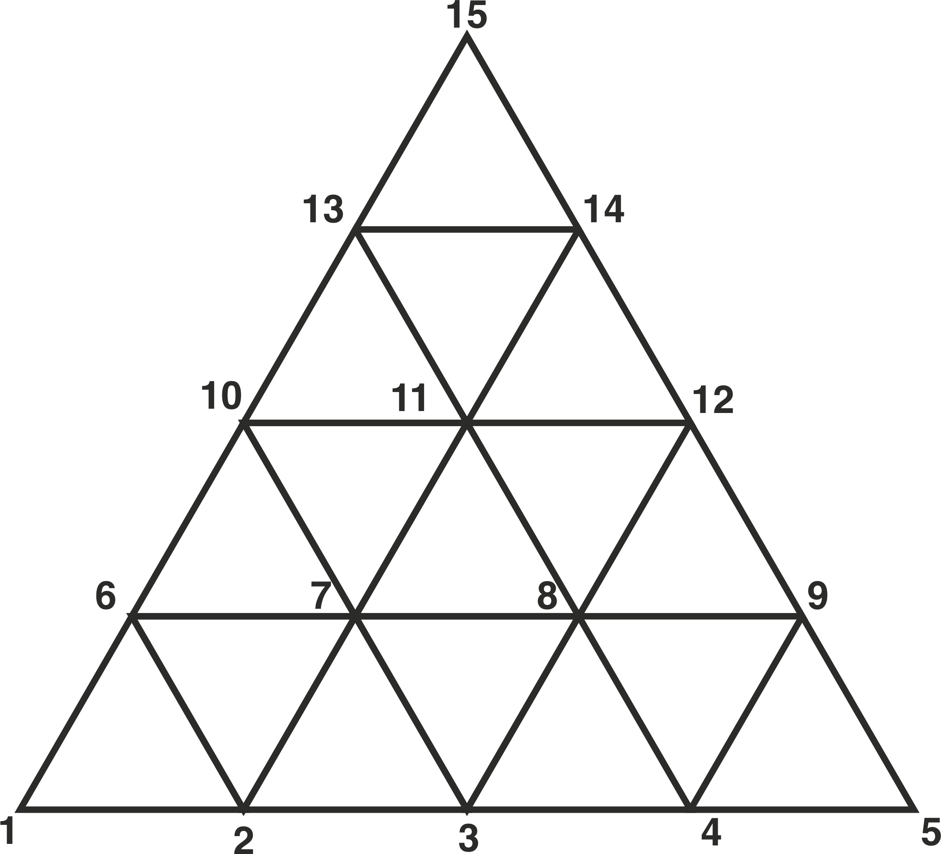
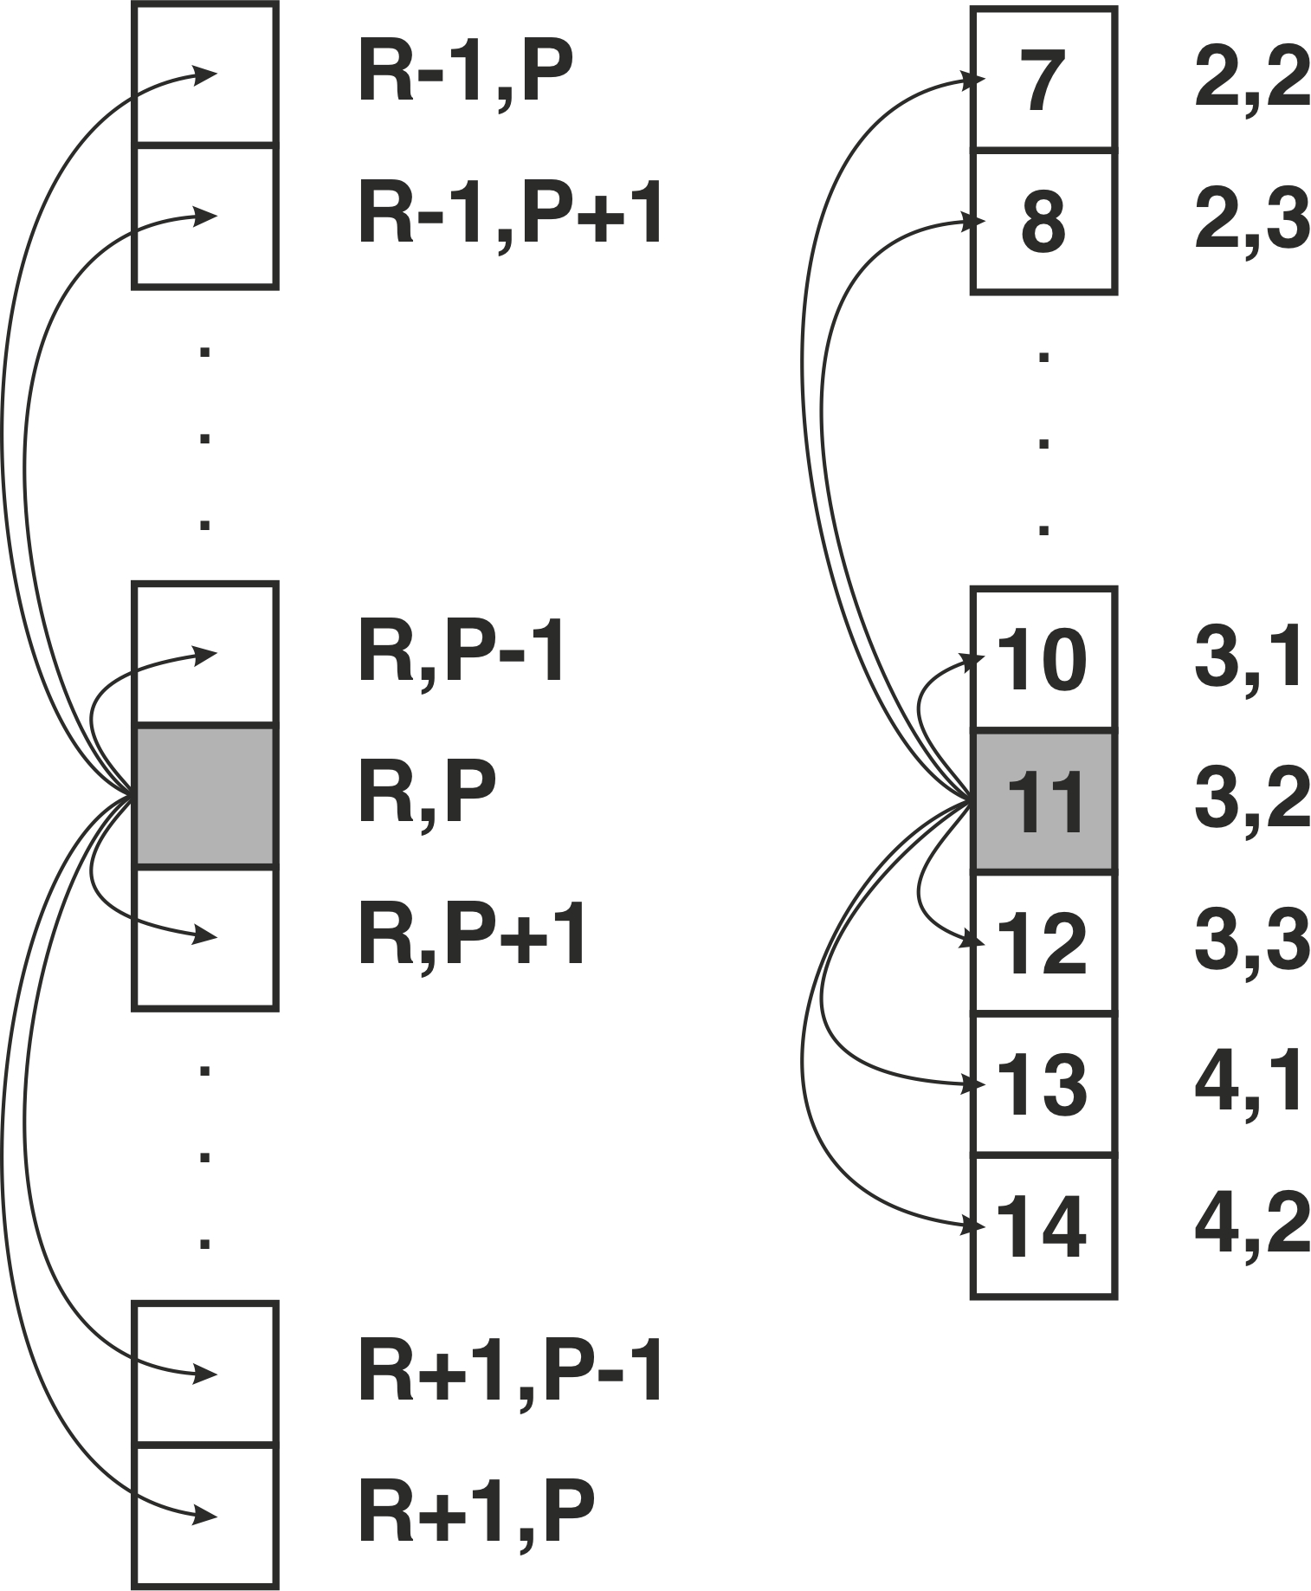
UNDERPINNING SCIENCES
Dynamic semi-structured meshes for fast numerical simulation of multi-phase modelling in the energy industry
Researcher: Amin Nadimy
PI: Prof Christopher Pain
Co-I: Dr Pablo Salinas
bp Mentor: Dr Andre Nicolle
Introduction & Project Aims
Results for P0DG
Structured grids are fast, memory-efficient and easy to implement, but poor to capture complex geometries.
Unstructured grids are captures shapes well, but are slower and more complex.
The project aims to generate a semi-structured mesh by using a coarser unstructured grid to capture the geometry and then generating the structured mesh with its advantages by splitting internally, Fig 1.
Fig 1. Splitting a coarse unstructured mesh twice to generate inner structured mesh.
The results for the P0DG in 2D show the gradual decay of the wave which matches with the theory, Fig 5.
Fig 5. 2D DGFEM for P0 elements
Data Structure
The data structure used in describing a mesh affects the simulation performance in terms of cost and resolution of simulations, so it should be:
Fast to access memory
Easy to use
Two data storage were introduced P0-discontinuous-Galerkin (P0-DG) and P1DG.
For P0 2 arrays are used, depending on the element orientation, Fig 2.
Fig 2. P0 data storage.
For P1,one long array will be used to store the data for P1 and the order of storing the data is shown in Fig 3.
Fig 3. P1 data storage.
Methodology and Results
Results for P1DG
In the first part of the project, the transport equation, Eq 1, has been studied using DG-FEM in 1 and 2 dimensions.
Forward Euler’s method is used for time discretisation.
Eq.1
The initial code for P0 in 1D was developed.
To reduce the oscillations, a residual based stabilisation method called Petrov-Galerkin (DPG) was applied, Fig 4.
Fig 4. Standard vs stabilised P0-DGFEM.
DPG has been chosen because, it introduces less diffusion compared to Large Eddy Simulation (LES).
Next, the code was extended to 2D using the same discretisation.
Initially, P0 was coded and validated against Finite Difference Method.
Then, P1 code was developed.
DPG resulted in fewer oscillations at the jumps, compared to the standard P1DG, Fig 6.
The success of simulating the wave equation in 1D & 2D with the standard DG and DPG methods are depicted in Fig 6 and Fig 7, respectively.
Fig 6. P1-DPG vs P1-DG with the same ICs in 1D
Fig 7. P1-DPG vs P1-DG with the same ICs in 2D
The next step will be to increase the order of stabilisation for further smoothness of the results.
Goals
Develop a semi-structured code that integrates structured and unstructured grids to generate a code as fast a structured-based codes with the flexibility of unstructured grids-codes.
The ultimate code of the project is to develop the general code with semi-structured meshes which can simulate the Navier-Stokes’ equation.
ICAM62 Date: 06/2021

